Slide 1

Vishwa Sangh Shibir
25th – 29th Dec 2025
Kanha Shanti Vanam
Bhagyanagar, Telangana

Slide 2
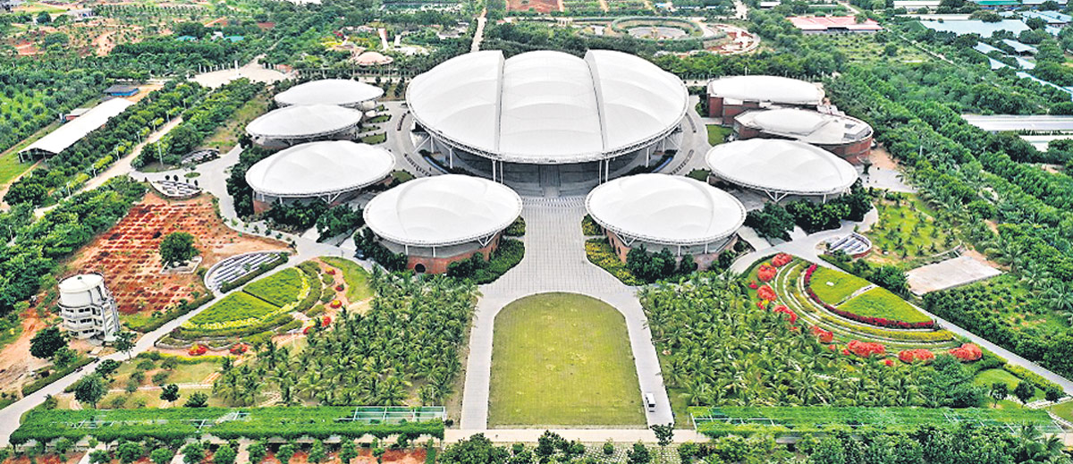
Kanha Shanti Vanam World headquarters of the Heartfulness Institute

Slide 3
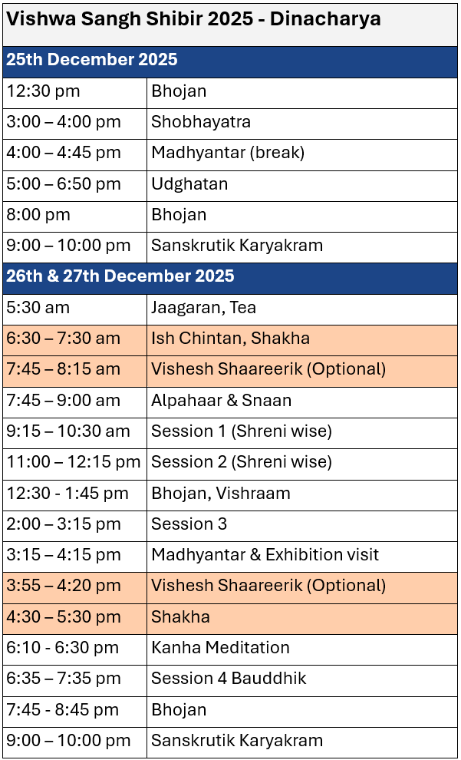
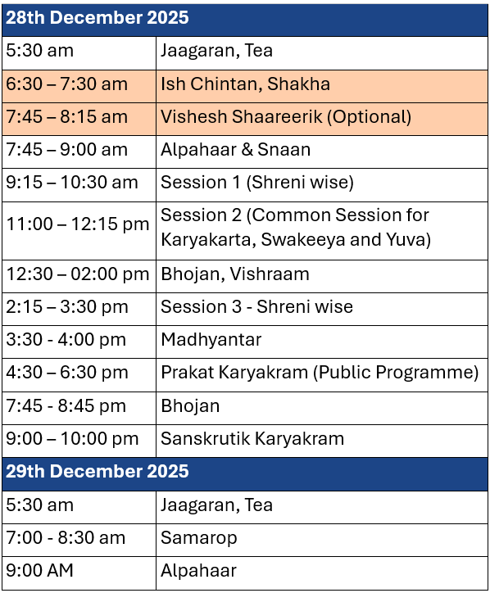

Slide 4
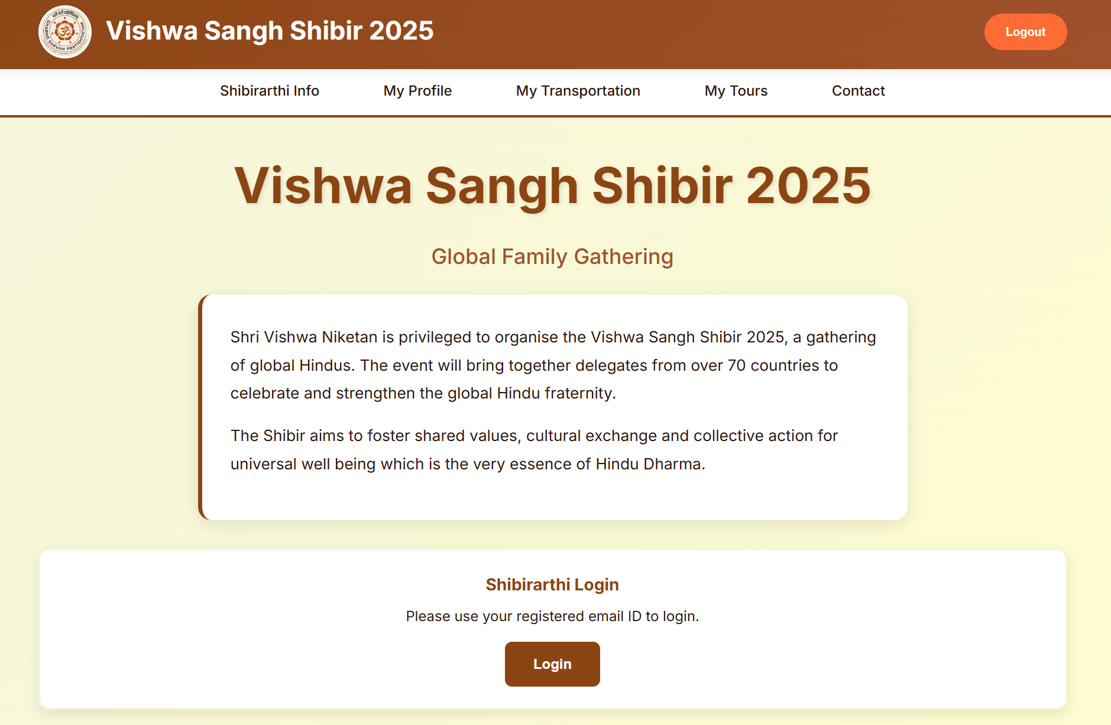
Shibir website - https://vss2025.org/
Login to website
Access shibir details
Update travel details
Select/update post shibir tour by Dec 7th

Slide 5
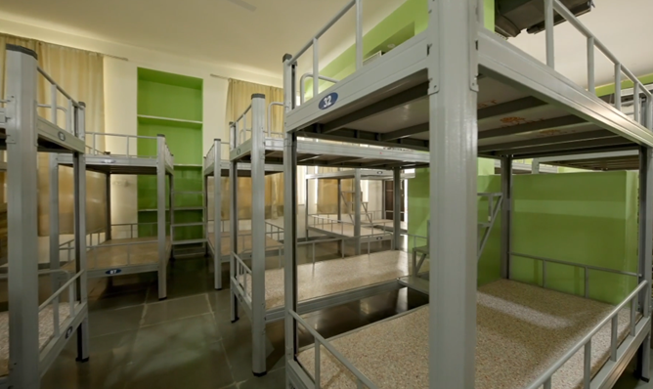
Nivas (Accommodation)
Decent dormitory style accommodation
Common wash area
Separate accommodation for swayamsevaks and sevikas
Children under 5 will be with parent

Slide 6


Shibir Ganavesh
Bring with you…
Black formal trousers (swayamsevaks),
Black salwar / leggings (sevikas)
Shoes and socks (preferably black)
Kurta – ₹ 700,
Saree (with blouse) ₹ 950.

Slide 7
Things to keep in mind
Transport arrangement only from airport/station to KSV or host families
Bring cash in INR (₹) for shulka, ganavesh etc.
Currency exchange facility will be available.
Pack enough clothes for 5 days.
Paid laundry facility available (24 hours turnaround time)
Dress code for mandir darshan during post-shibir tours
No mobiles during sessions
Be judicious in the use of social media. Focus on connecting with everyone in person

